Slide 1
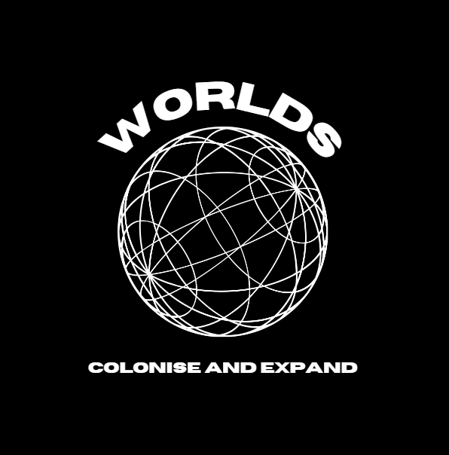
Introduction to Level Design and Asset Creation - PORT1
By Liam Barrett - ST20228164
Repository Link

Slide 2
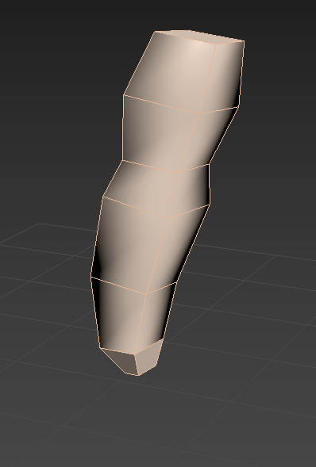
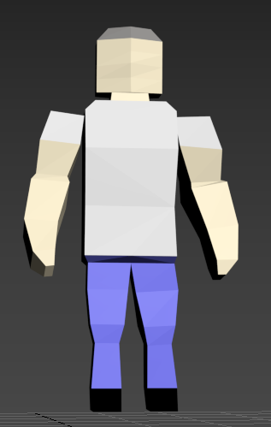
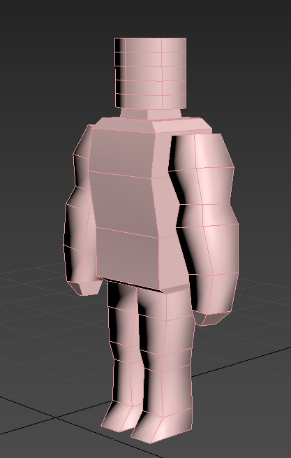
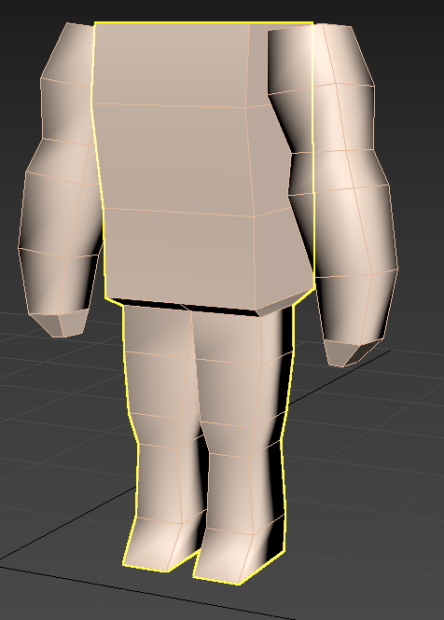
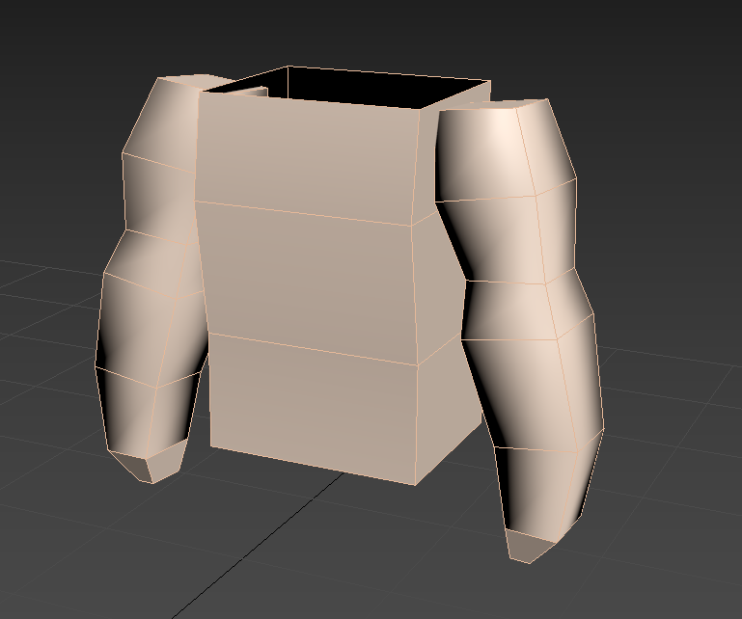
3D Modelling
Poly Count: 324
For the first model I decided to make a Male NPC that would be common throughout the game and would be used often, I made a low poly human and dressed him as a modern / slightly futuristic man.
I started modelling him by making his hands and arms, after many iterations of this I produced his hands using the extrude and inset tools to make his fingers
Model 1 – Male NPC
I then added his body which started out very blocky but with manipulation of the edges and vertices I was able to make it more human-like.
I then added his head which seemed too round which I sculpted using the vertices to be blockier as to more fit with the rest of the body. Finally finishing the model by adding the smooth modifier to make him look cleaner.

Slide 3
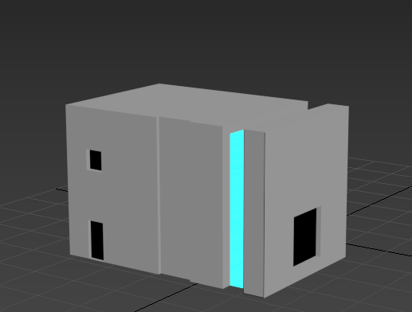
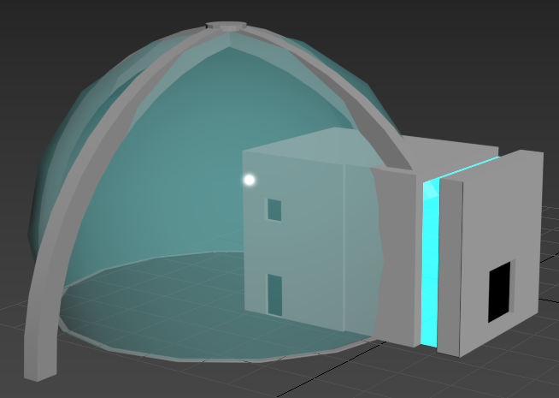
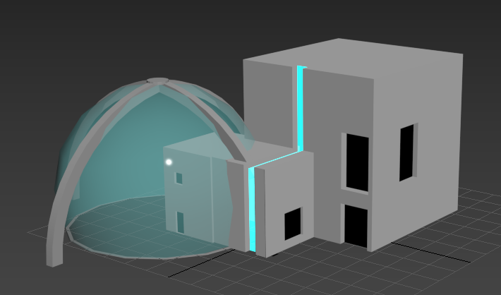
House Model
For this model I wanted to make a futuristic looking concrete house that would fit in a SCI-FI concept, I added the blue light by dragging the faces inwards.
I then added the dome / biosphere to the house to add some authentic space travel looking aesthetic, I used the bend modifier to bend the pillars that attach to the top of the glass
Lastly, I added the bigger part of the building to finalise the Phase 3 of the house building, to create the windows and doors I took inspiration from Populous of indenting them into the house and adding black to obscure the windows/ doors.
Phase 1 – 41 Polys
Phase 2 – 472 Polys
Phase 3 – 507 Polys

Slide 4
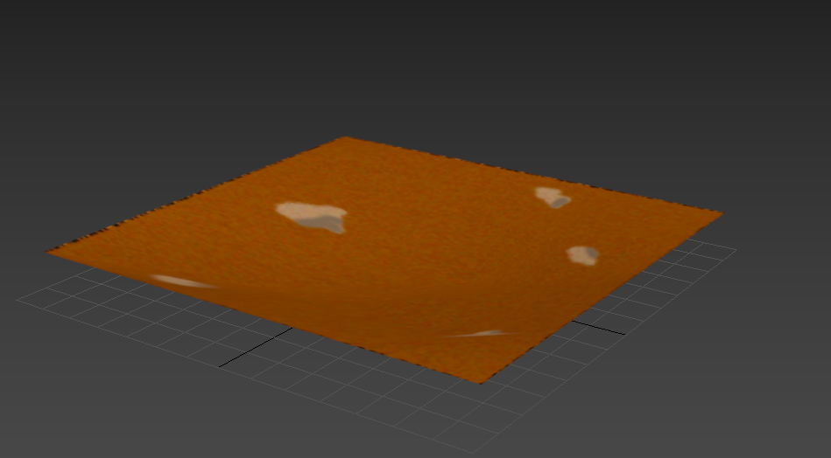
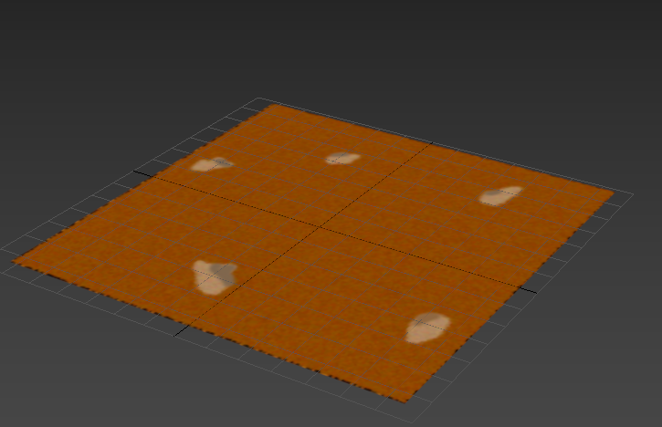
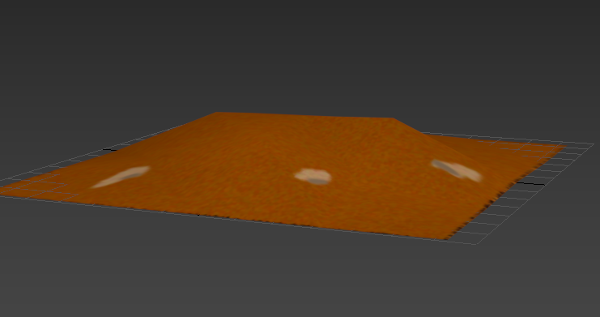
Mars Ground Assets
Flat Ground: Polys - 32
To create the textures for these assets I used photoshop to make my own textures.
I then went into 3Ds Max and added a plane object which I then added the texture to using a bitmap material.
To then create the raised and lowered land I used the conform tool within the Freeform section to raise and lower the middle of the plane.
Raised Ground: Polys - 16
Lowered Ground: Polys - 16

Slide 5
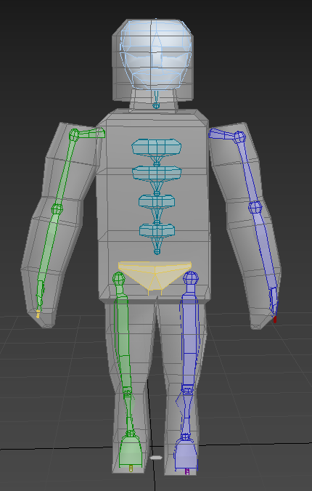
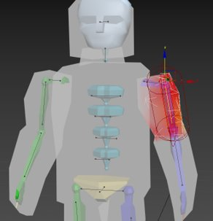
Animation
Rigging Male NPC
To Rig the Male NPC, I started by adding the built in skeleton system of 3Ds Max and then had to customise the skeleton and rig it to the size of the character. Therefore, I had to move the skeleton around and change the size and number of some of the bones. Particularly in the arms, legs and spine a lot of changes had to be made.
After rigging the skeleton to fit the body, I had to skin the body to the skeleton, however once I did this there was issues with bones moving parts of the body that they shouldn't. To fix this I had to go through the Edit Envelopes tool and customise what each bone controls and moves within the body, after a lot of tweaking I was able to get the model to move as a human would.

Slide 6
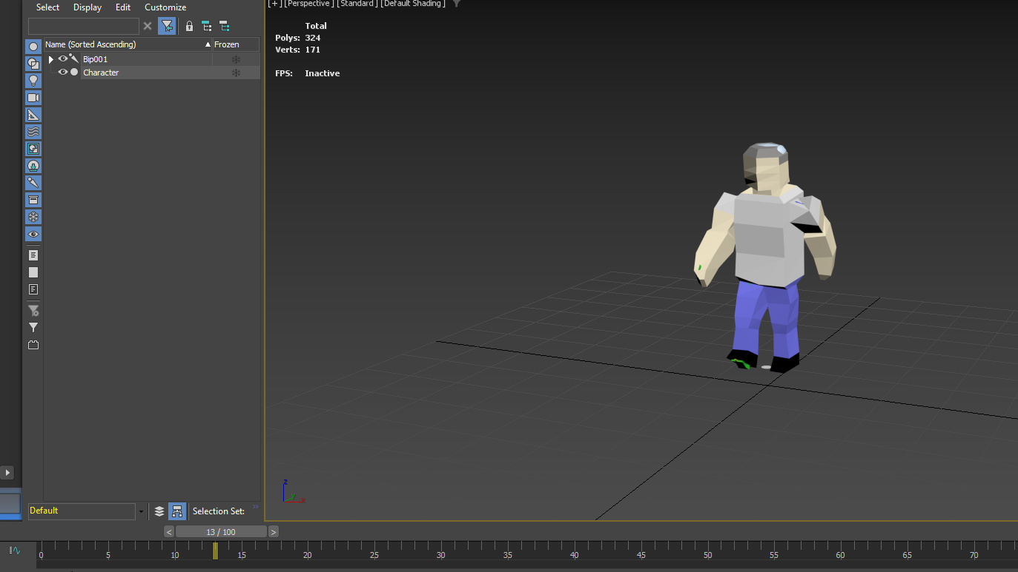
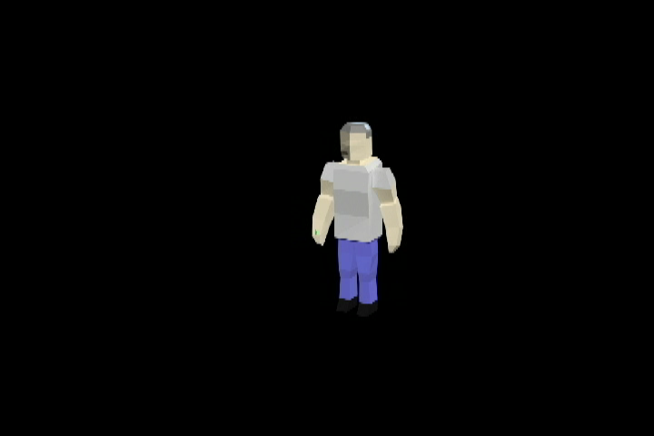
Male NPC Walking Animation
For the animation for this NPC, I wanted to create a walking animation as this is the main thing the NPC would be doing within the game, and it would be able to show off the character and its rig the most.
To create the animation, I first started by moving the legs and then the arms, after realising it looked a bit weird, I then made the head and the body move along with the walk to make it look more realistic to actual walking.
Despite the walking animation being short, I intended this as the animation can be looped to be able to make a longer walk.

Slide 7
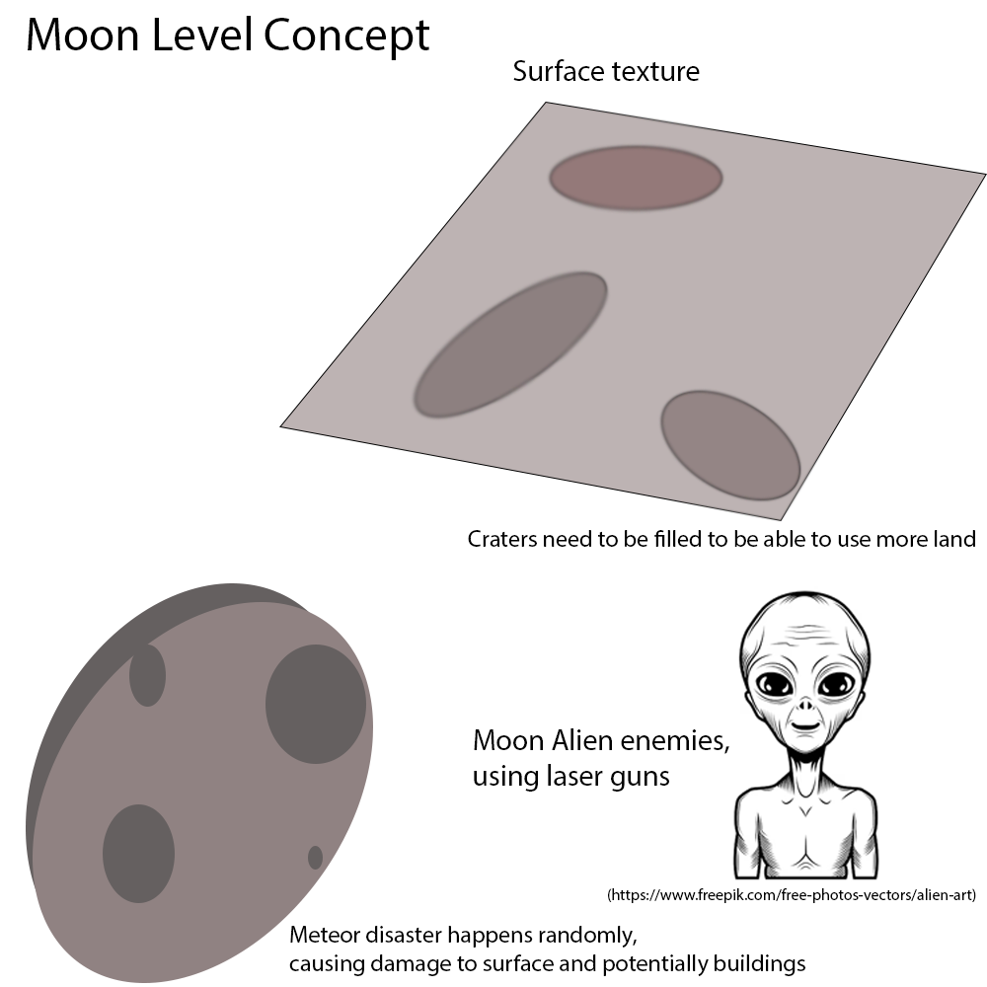
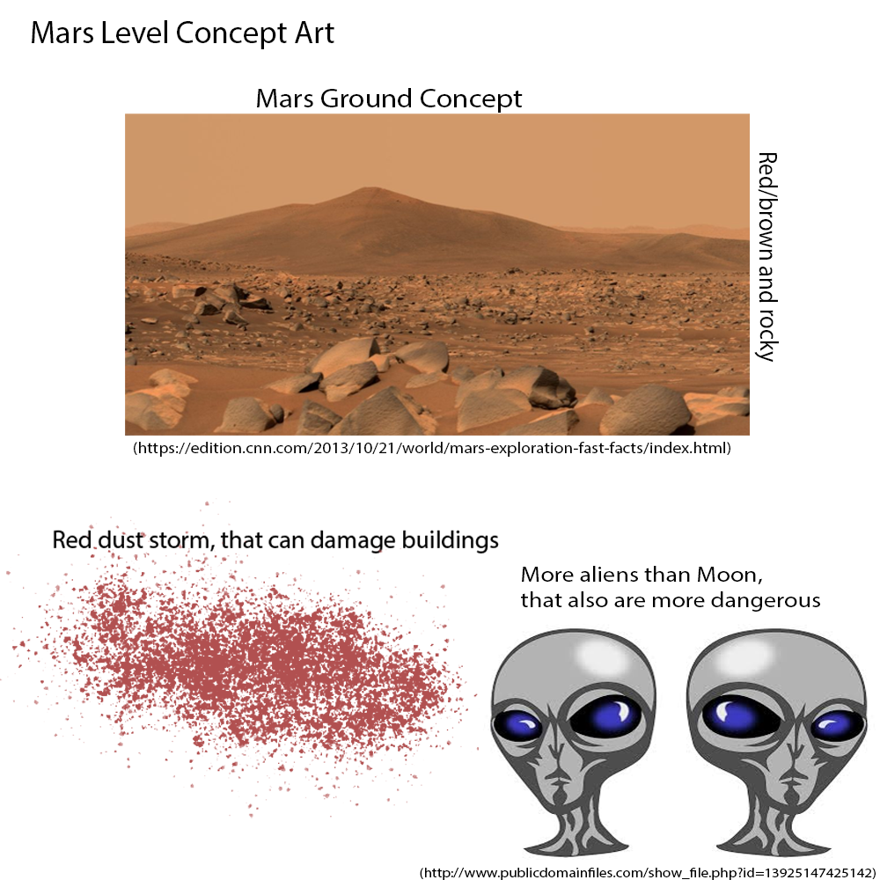
Level Design
Concept Art
Using Photoshop, I created this concept art / boards to have an idea of what each level would include and how they would be different from each other as well as how the difficulty would scale.
For example, each level has its own unique environmental issue that can cause problems for the player. These will be more frequent in the Mars mission to increase the difficulty as it is the second mission as well as there being more Enemies to deal with

Slide 8
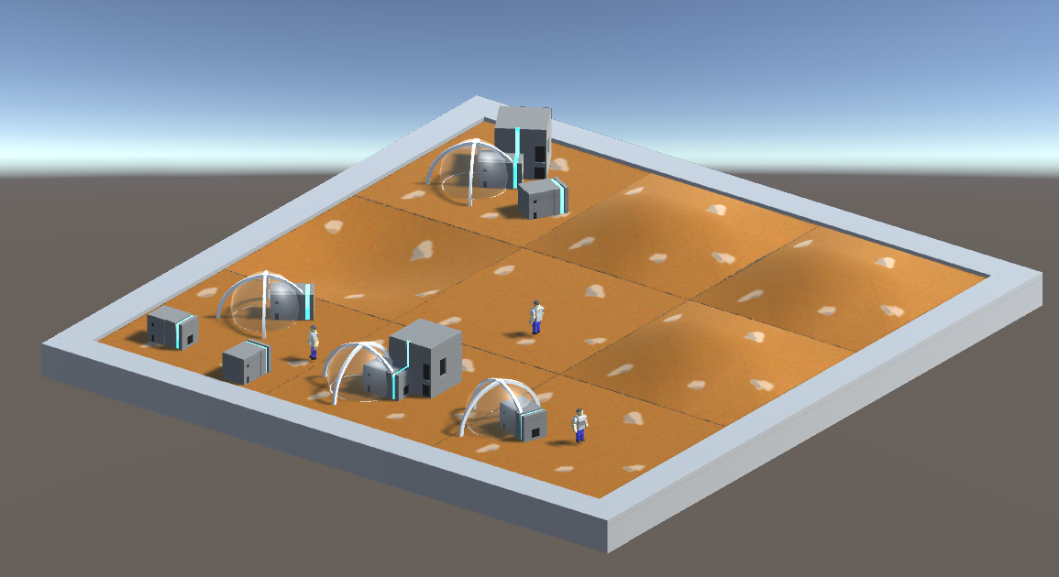
Mars Level
This is the final level design of the Mars level, imported into Unity. I designed it this way to be able to best show off all the assets for the level. I then added a barrier around the outside to contain the part of the level that is currently being viewed.

Slide 9
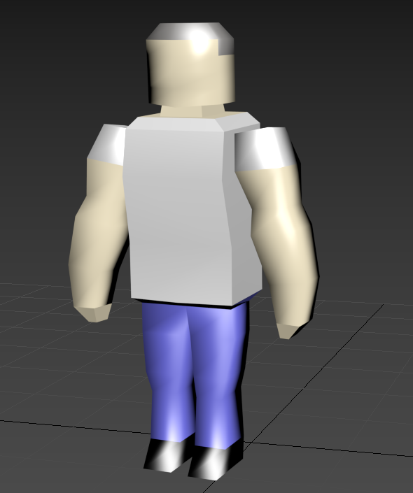
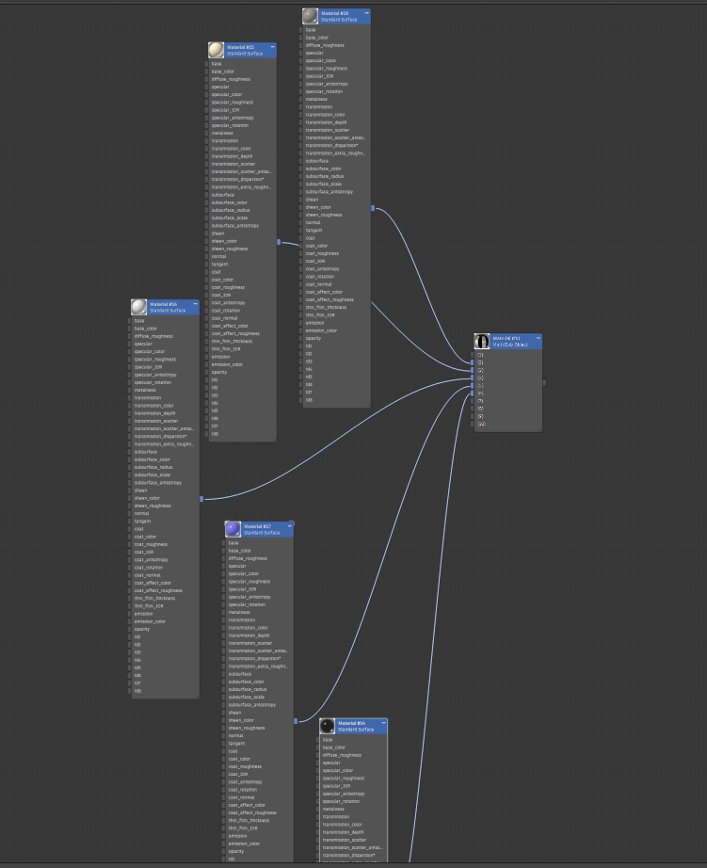
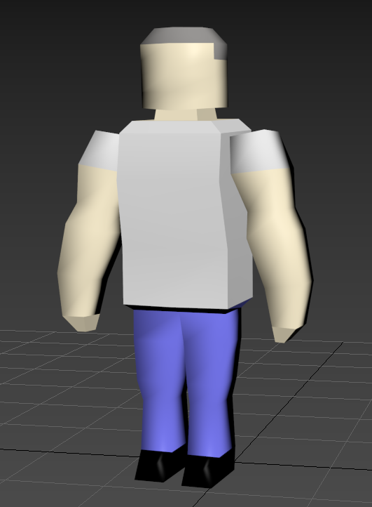
Textures
After creating the model and adding base materials to it, the character was looking somewhat human-like however the materials and textures weren't setup to each part of the body correctly
To add the materials and textures I used the faces of the model and added them to different material IDs then using a Multi/sub-object to apply each material to the faces
I had to tweak a lot of the variables and settings within each of the materials to get them to look appropriate for each part of the body and clothes
I kept a little glossiness and reflectivity on the skin and made it so light doesn’t reflect too well off his clothes and shoes. Then added some roughness to the clothes to make them look more like clothes
Finally, I added the Smooth modifier to the model and made sure to slightly tweak each material to fit with the new smoothness. Such as making the hair slightly reflective.

Slide 10
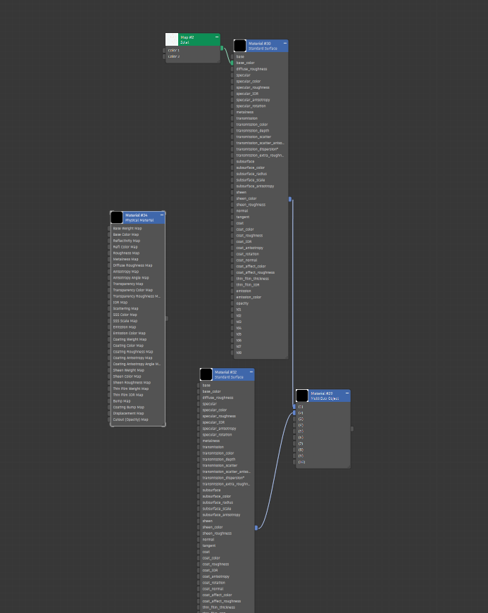
House Model Texturing
For the texturing of this model, I had to use a few different techniques, first for the main house I used a concrete texture in 3Ds max.
Then for the light on the building I added a hue effect to material to illuminate around it.
Lastly for the dome / bio-sphere I had to make it look like glass, so I added a blue tint and transparency to it as well as adding some specular to it to have it reflect light.

Slide 11
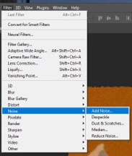
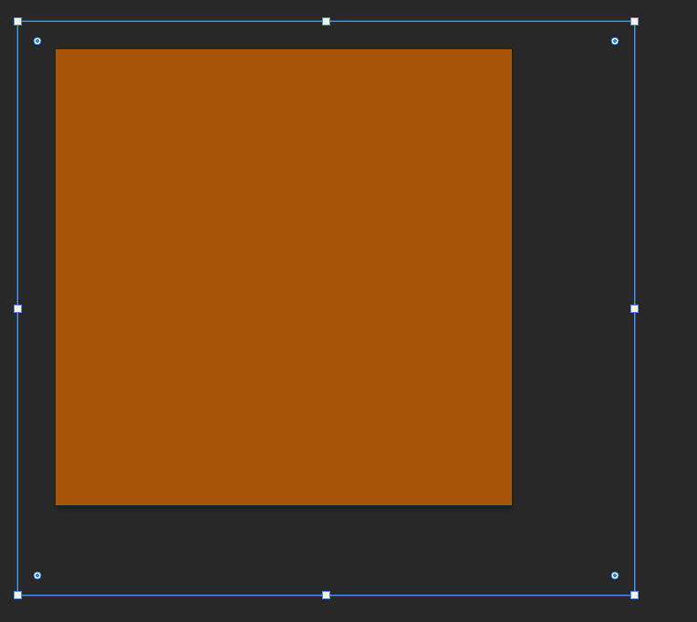
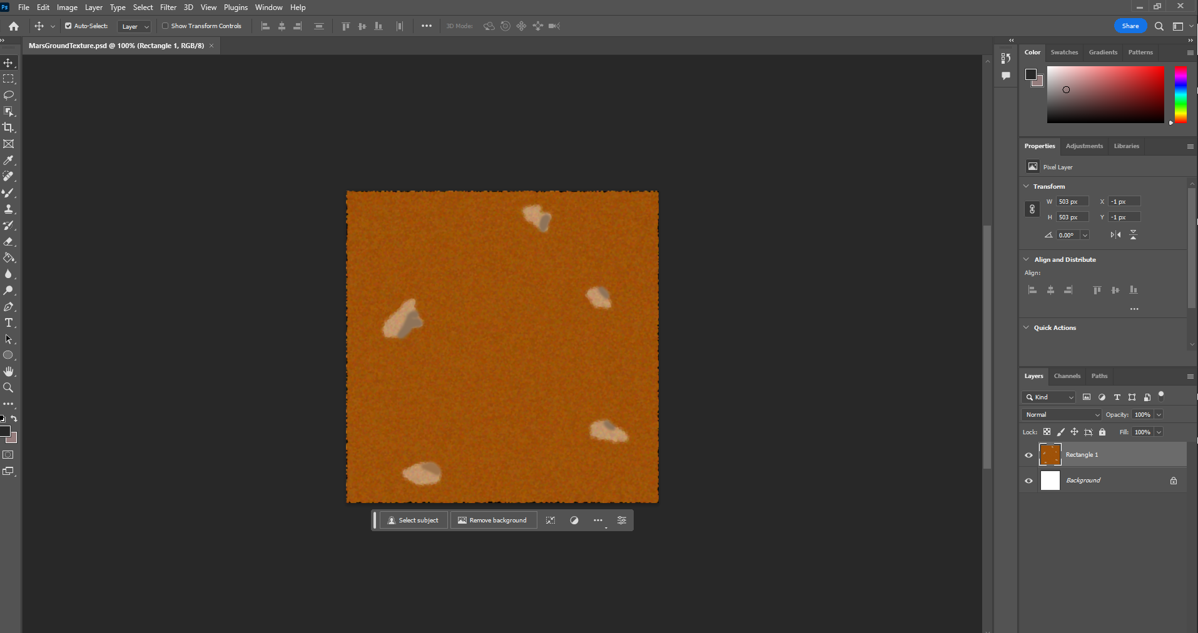
Mars Ground Texture
To create this texture, I used Photoshop. I started by adding a red-ish brown box, I then drew on the rocks using the brush. After doing this I used the blend tool to blend the rocks in slightly before using the filters option of Photoshop to add noise which gives the grainy sand-like texture similar to that of Mars.
Then in 3Ds Max I used the Bitmap material to add it to the Plane to create the asset

Slide 12

Audio

Slide 13
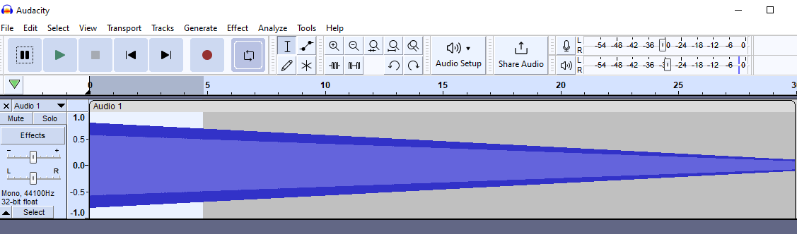
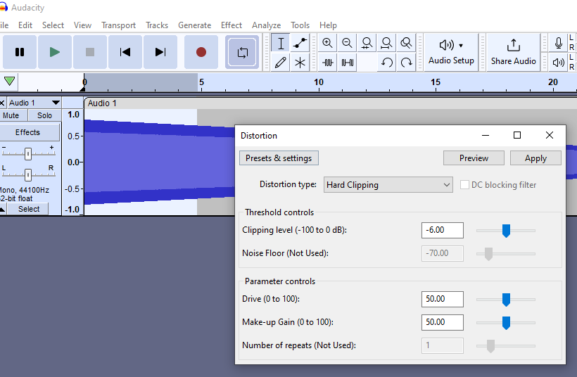
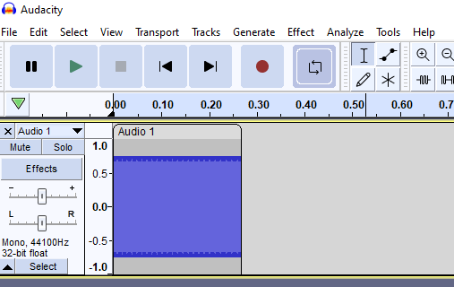

Beep Sound Effect for Power Usage
To create this diegetic sound effect I started by using the Generate feature of Audacity to generate a chirp
I then added a distortion effect to the start of the chirp
I then cut it down to a quick beep that sounded suitable

Slide 14
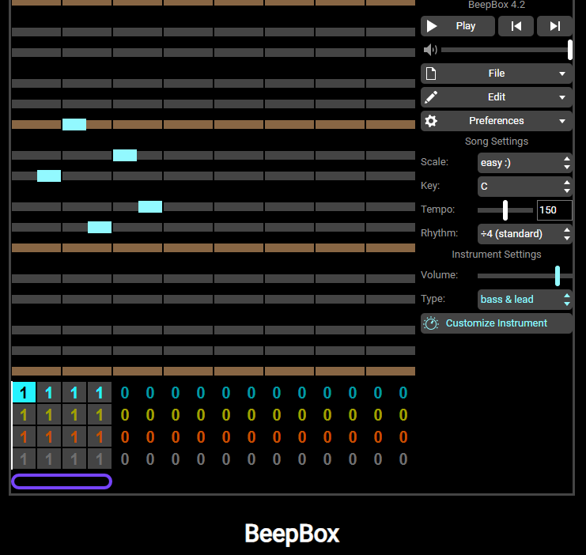
Level Completion Sound
To create this non-diegetic sound effect, I used an online song / sound effect creator BeepBox, I created a simple sound bite that sounds like a triumphant ending

Slide 15
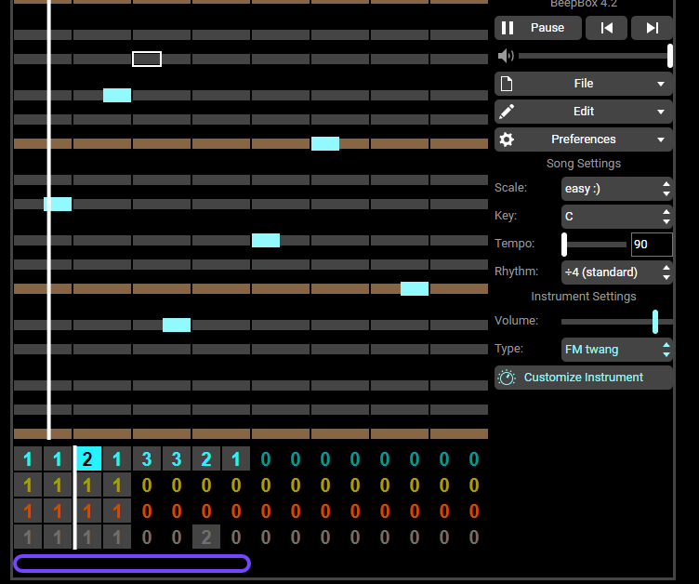
Background music
For this non-diegetic sound effect for the background music, I decided to use BeepBox again to make some background music for the game and due to the theme of space I decided to make it futuristic sounding and have it sound quite empty to convey space travel

Slide 16
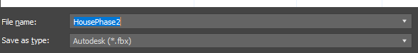
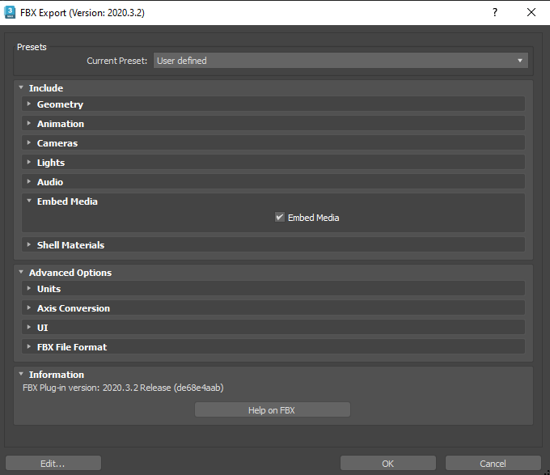
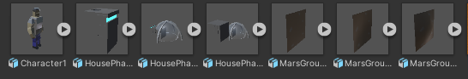
Content pipeline
The content pipeline was not difficult for me as 3Ds Max has the capability to export files as .fbx and Unity my chosen game engine can import assets in .fbx whilst keeping the textures and materials of it by enabling the Embed Media option when exporting.
However, when trying to export the files and importing into Unity, certain materials or textures would not transfer across due to not being supported by any program other than 3Ds Max, this made it, so I had to edit some of the models to change the textures and to get them to work in Unity. An example of this is with the house model, originally, the model was going to be marble with red dust on parts of the house using a texture map to simulate mars dust on the house however this was not able to work outside of 3Ds Max, so I had to change the building to concrete.

